Slide 1
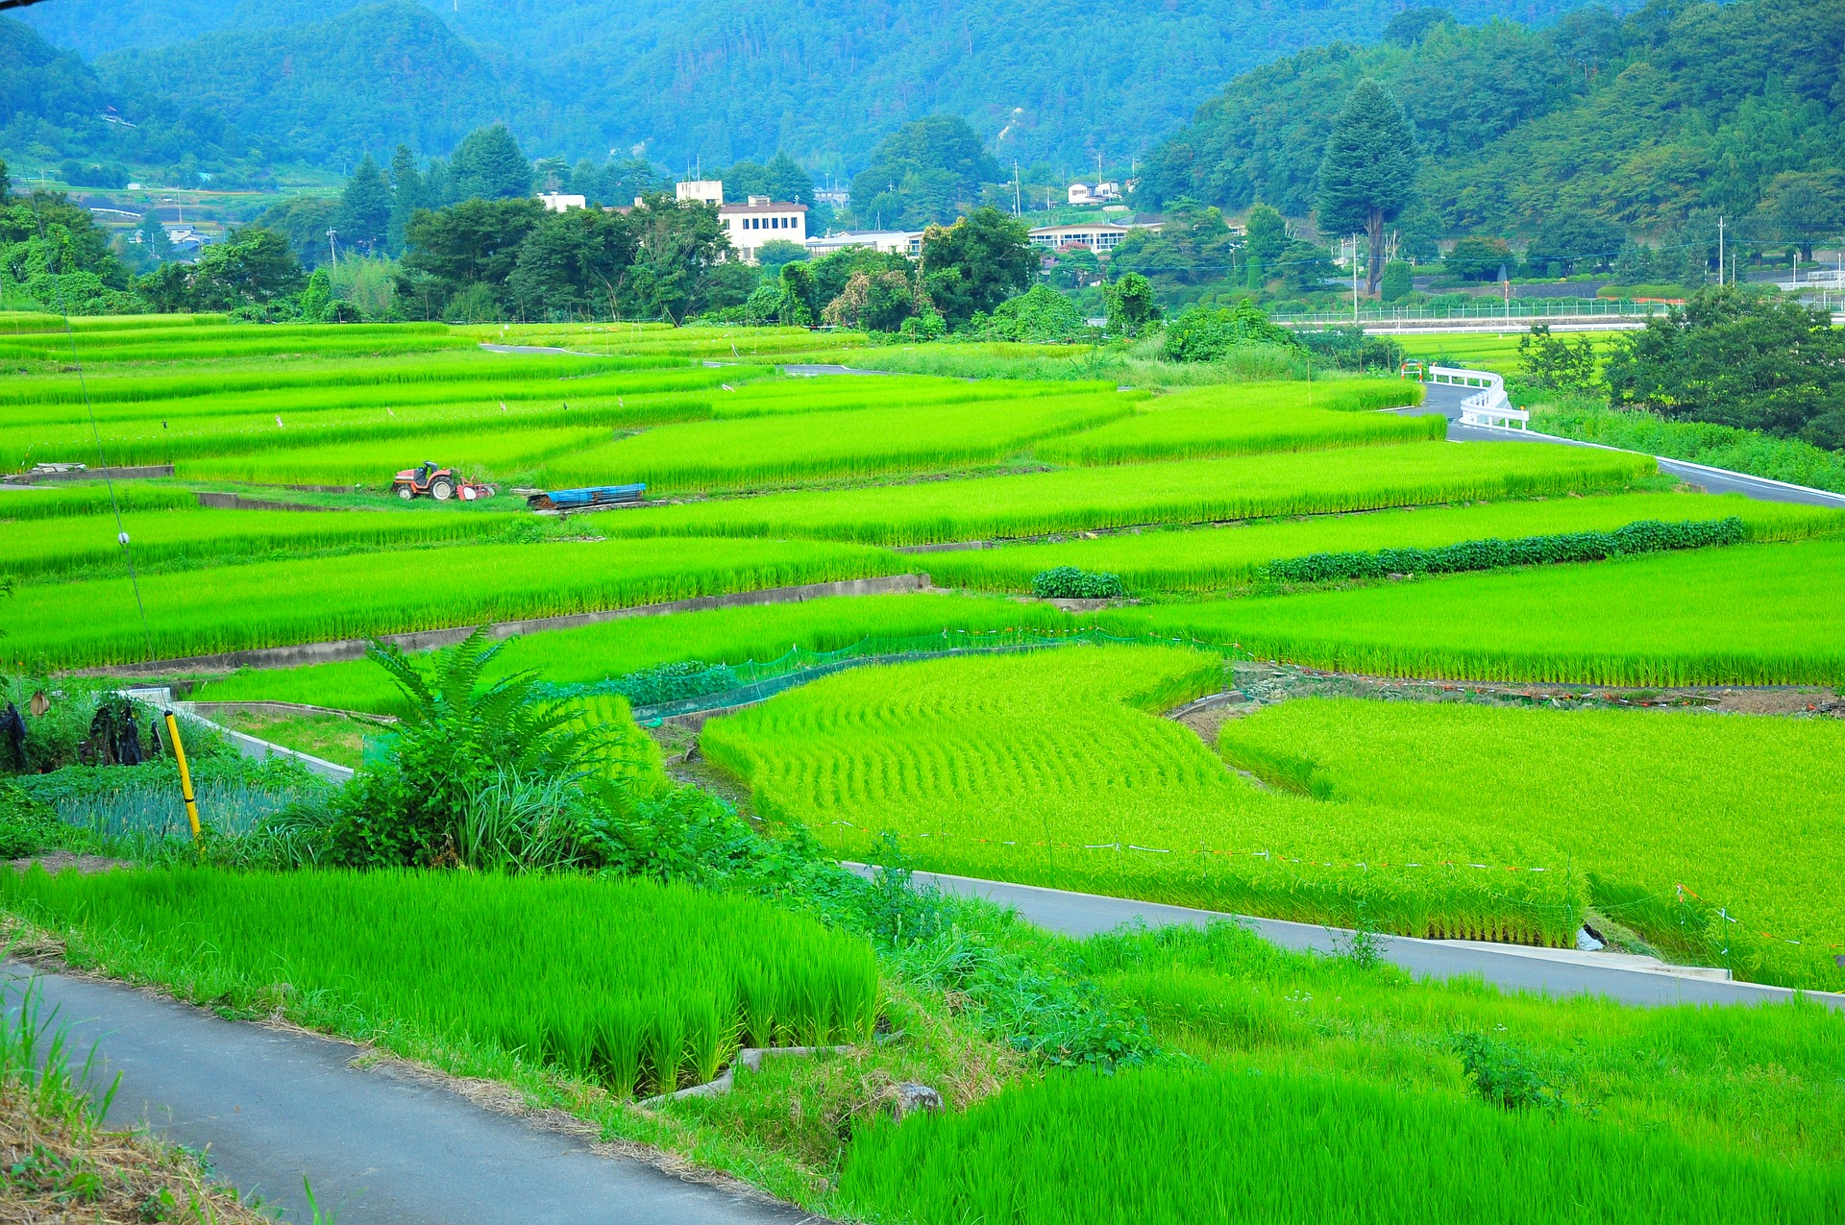
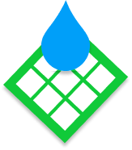
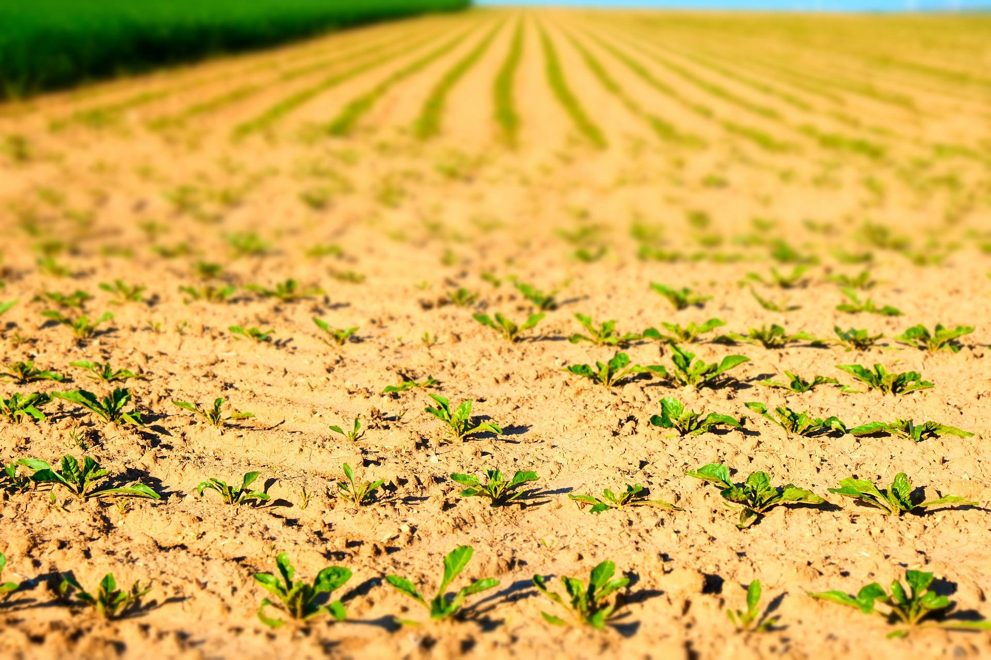
What is Farm Grid?
Our mission is to help farmers manage their water usage efficiently without the high price tag.
What’s the Current Problem?
Over 800 trillion gallons of water is wasted globally in agriculture each year.
The world population is estimated to reach 9.8 billion by 2050. Farm resources must be used efficiently to meet food demand.
A $6.8B global precision agriculture market has few low-cost solutions that fit the budget of family-owned farms, which are 50% of the U.S. market.
We are working to design low-cost and wireless sensors to help save farmers resources and money.
Water misuse leads to poor yields, costing small farms an average of $7,500 in wasted expenses yearly.

Slide 2
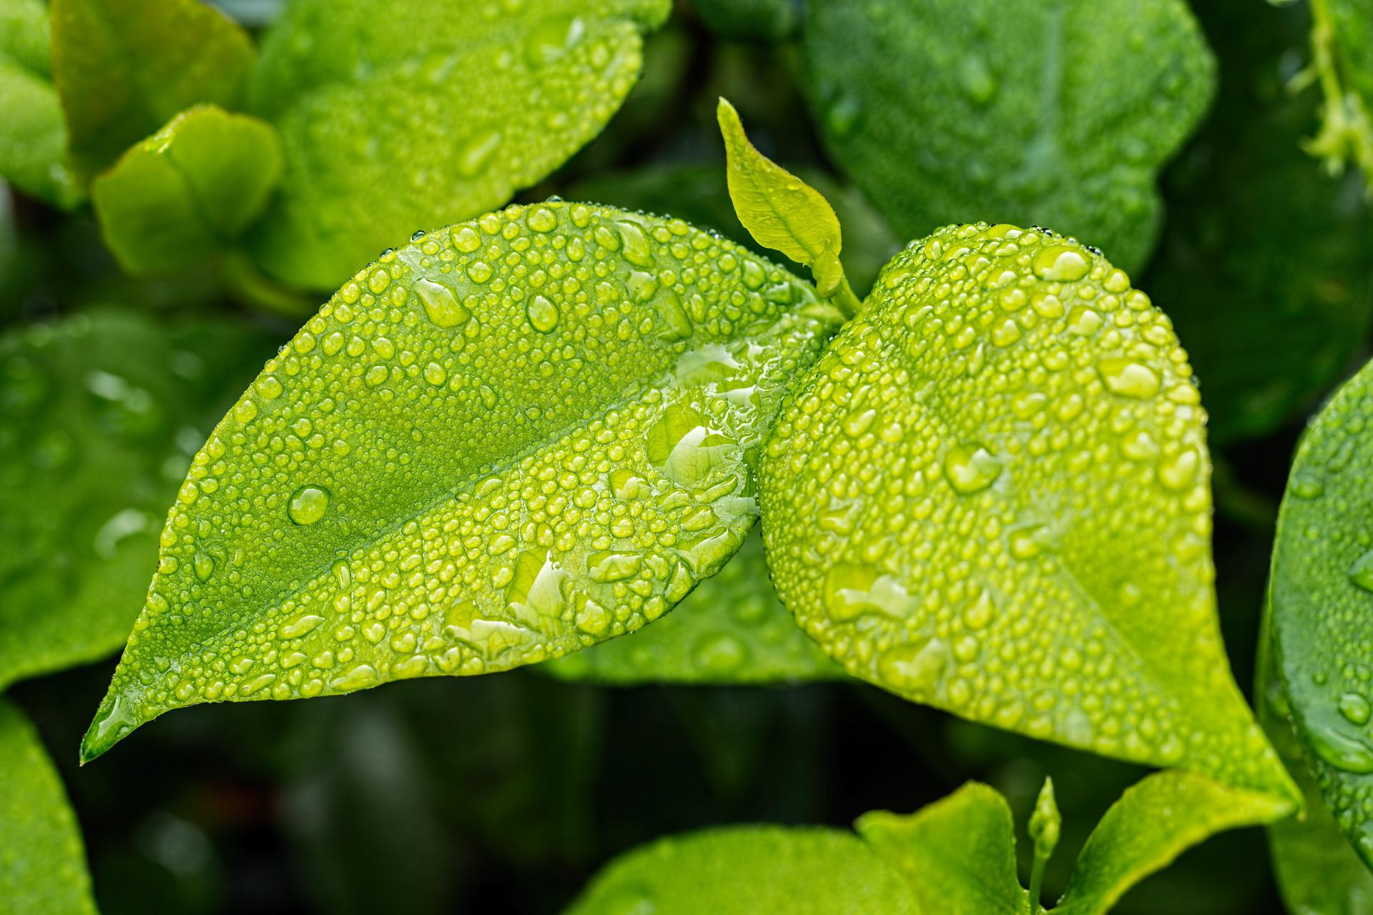
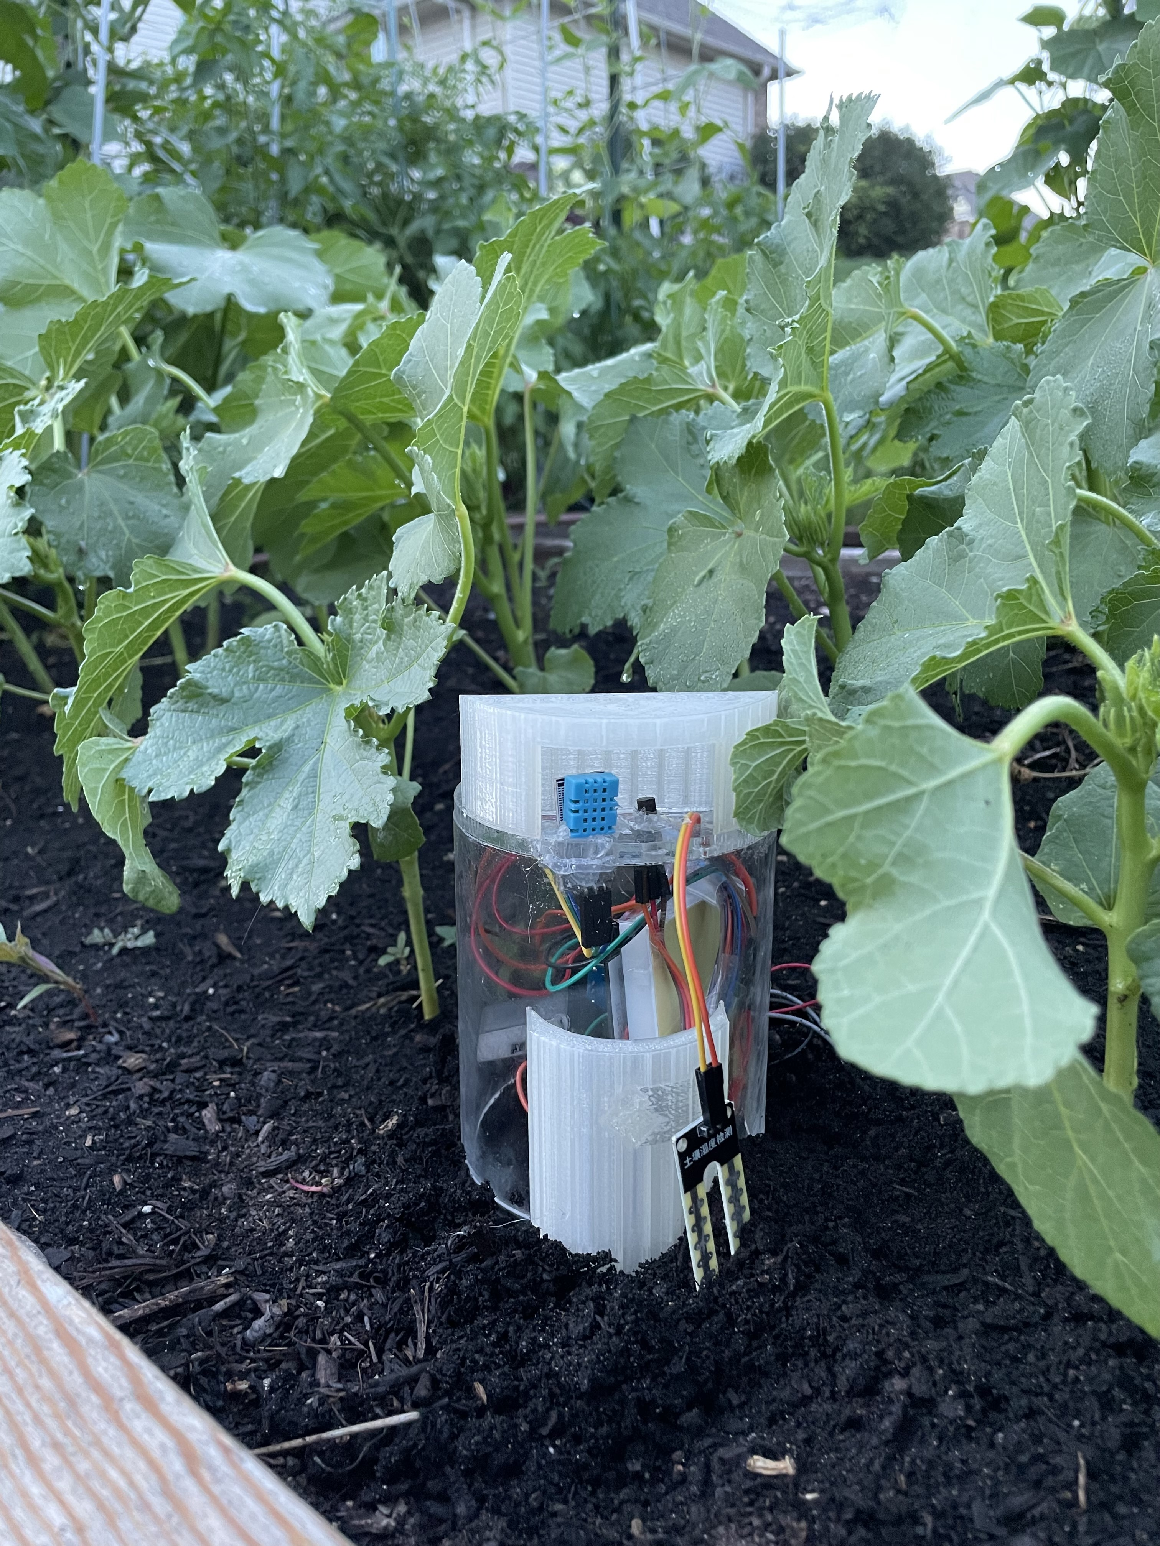
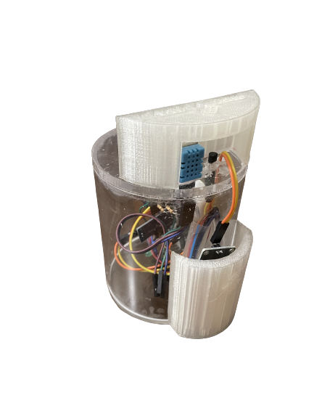

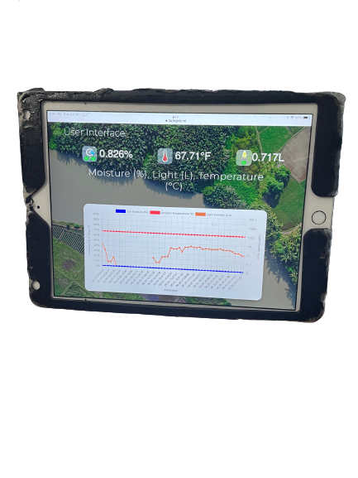



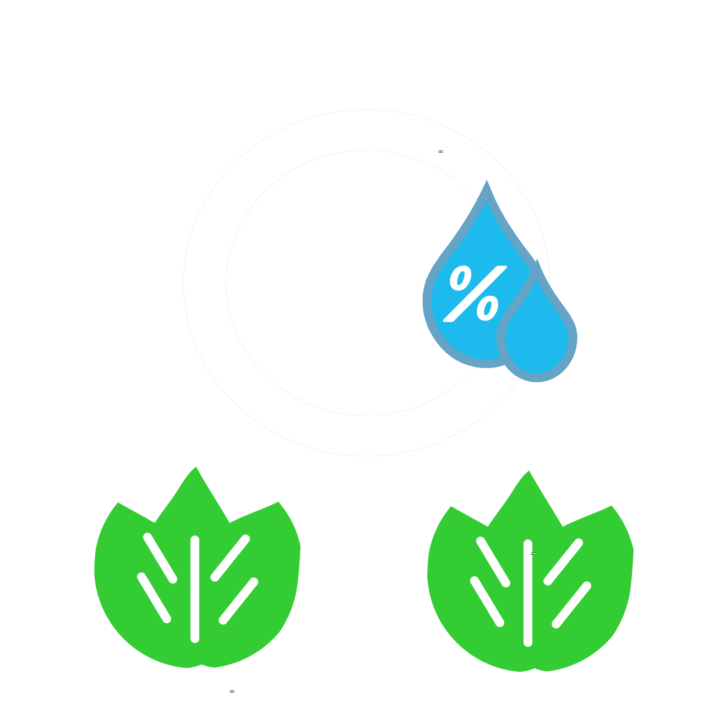
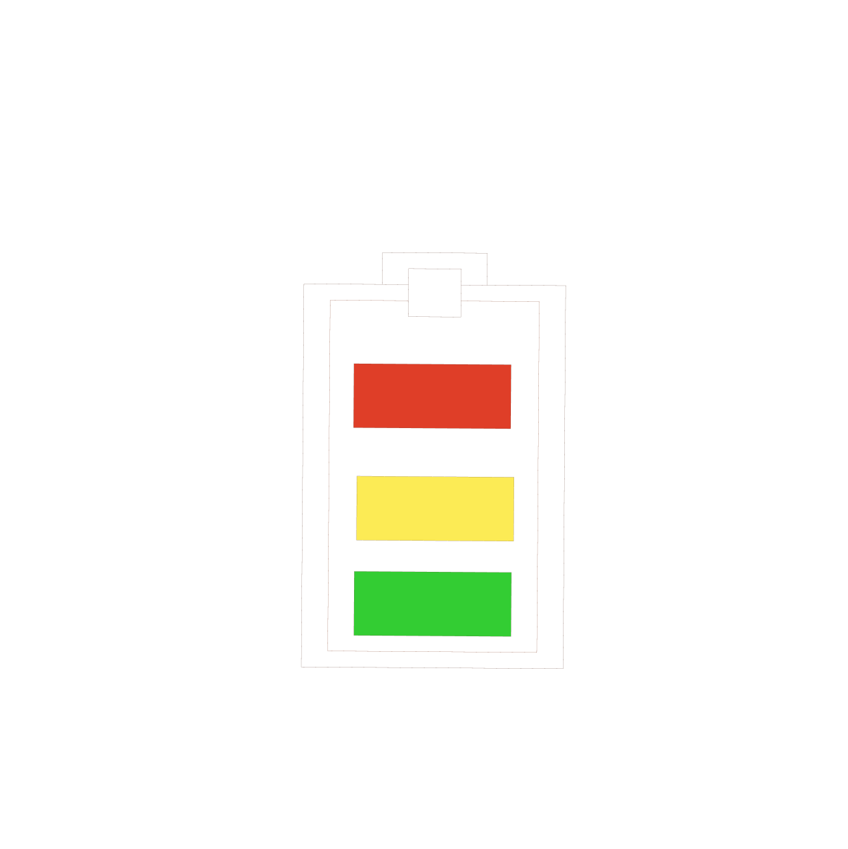
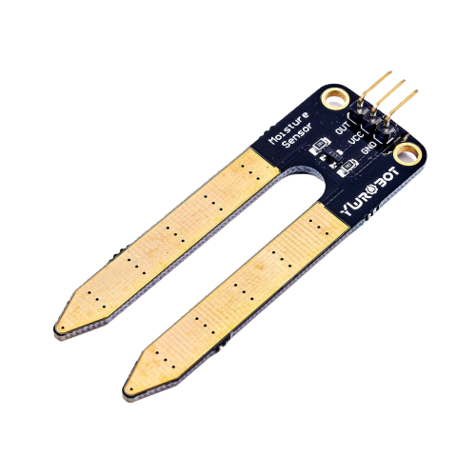
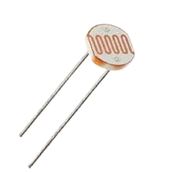
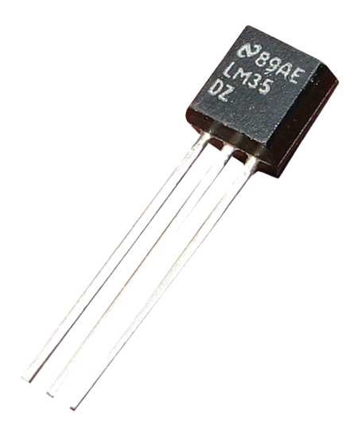
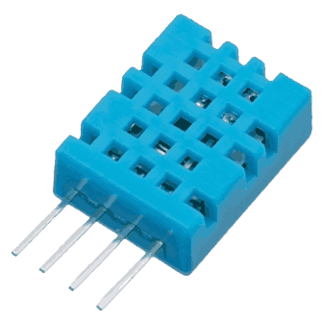
FarmGrid closes the gap between farmers and technology.
Sustainable Device
Intuitive User-Interface
Sensor Data
Low-cost hardware
Solar powered batteries
Passive 24/7 monitoring
Automated Updates
Data visualizations
Remotely accessible
Each device comes with:
A FarmGrid device in the garden. Our devices publish data wirelessly from the garden to you.
Temperature
Soil Moisture
Humidity
Light

Slide 3
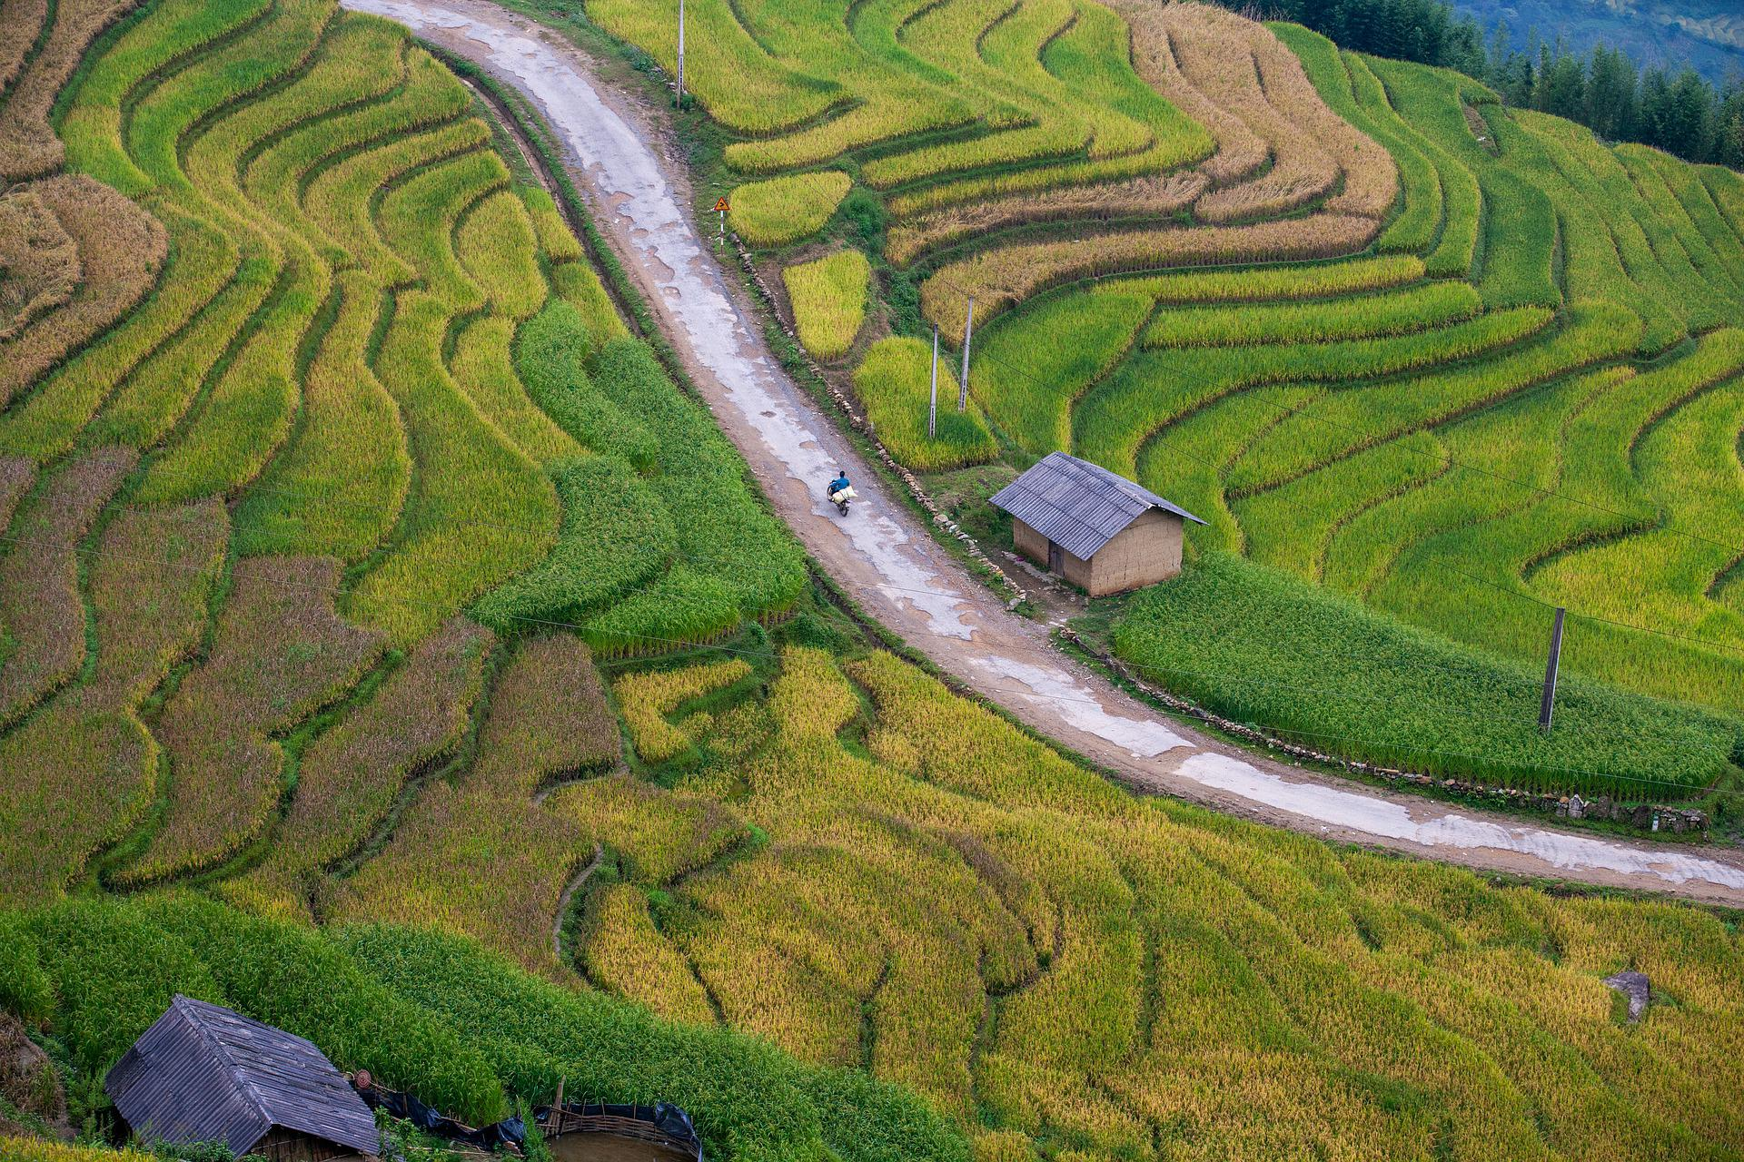

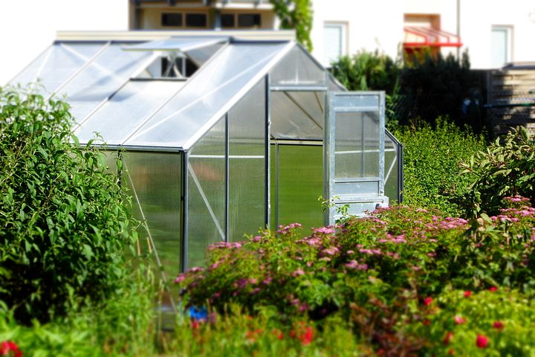
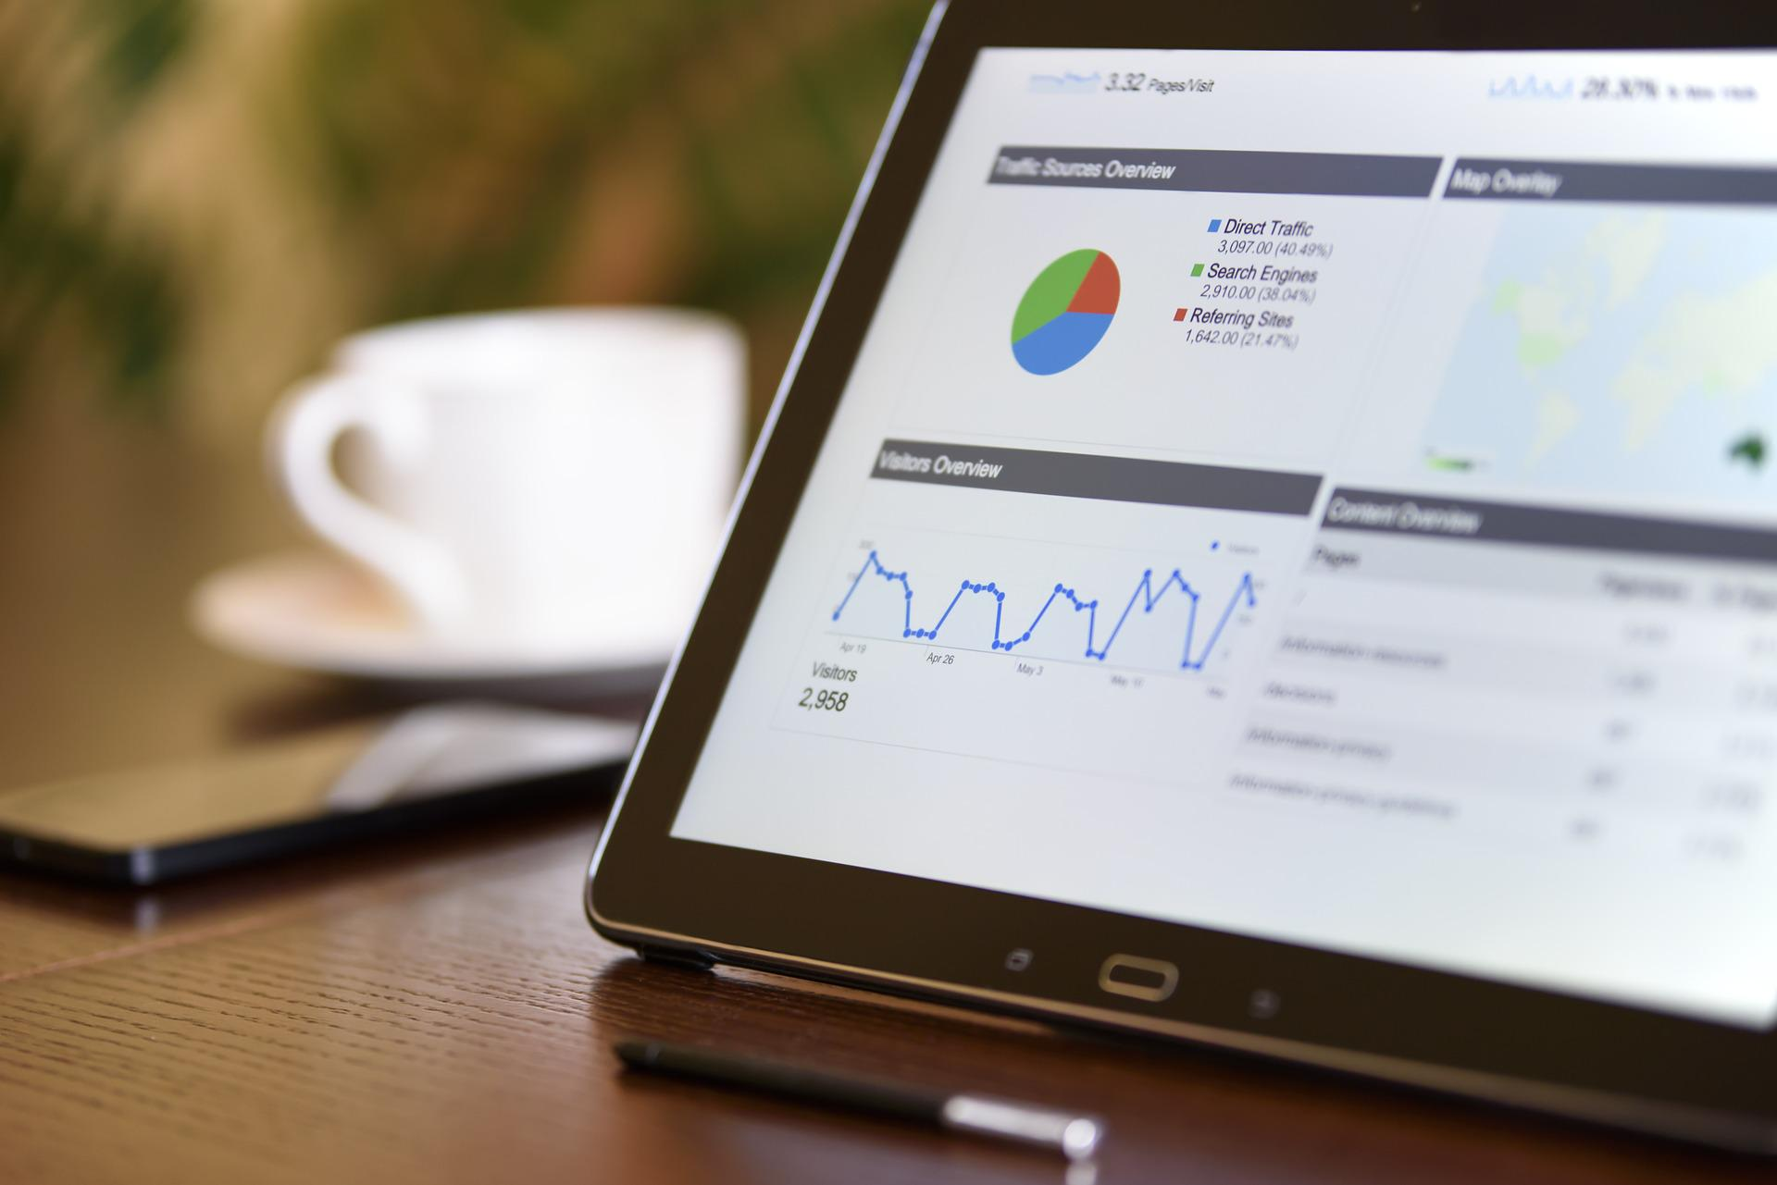
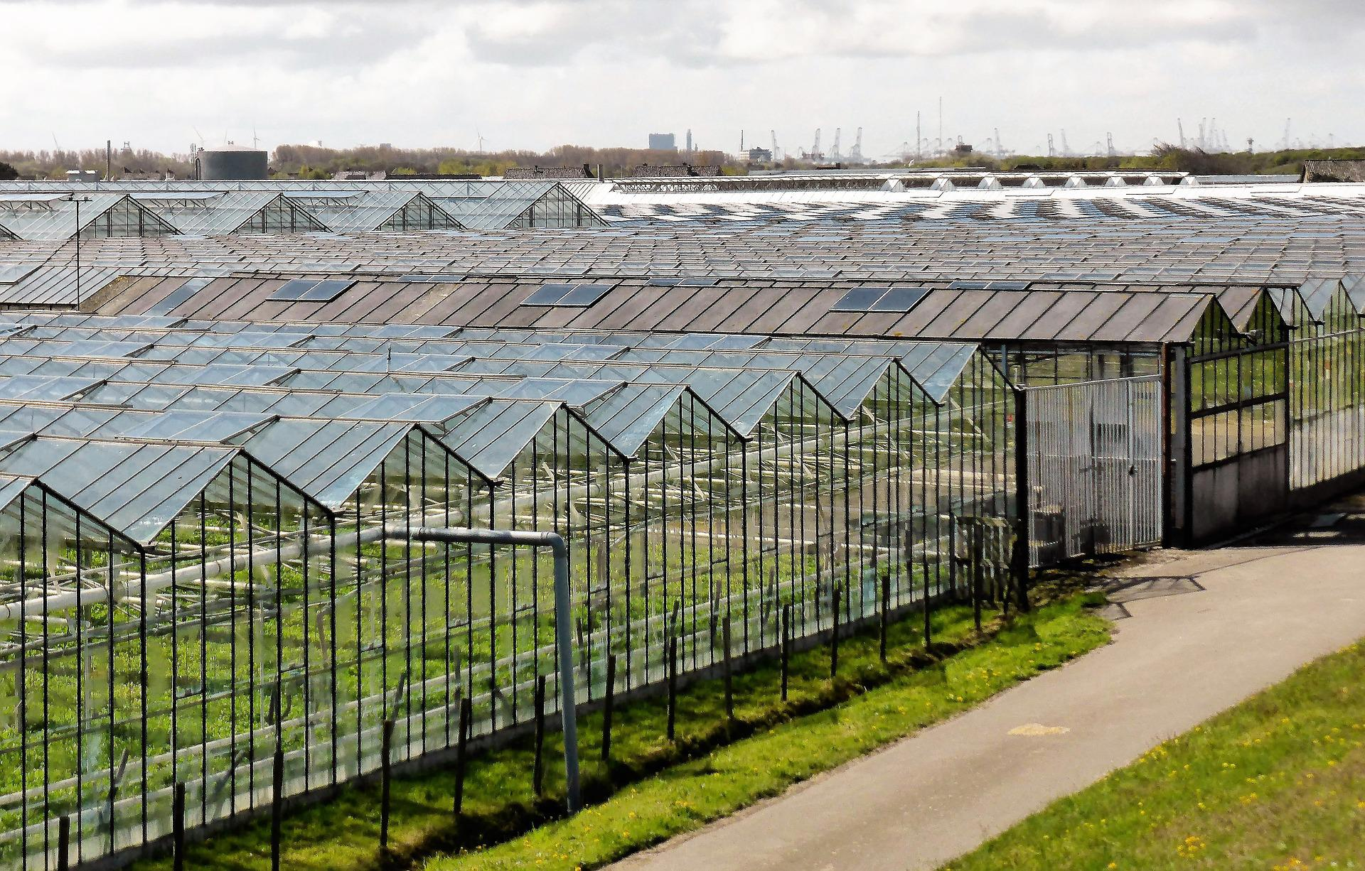
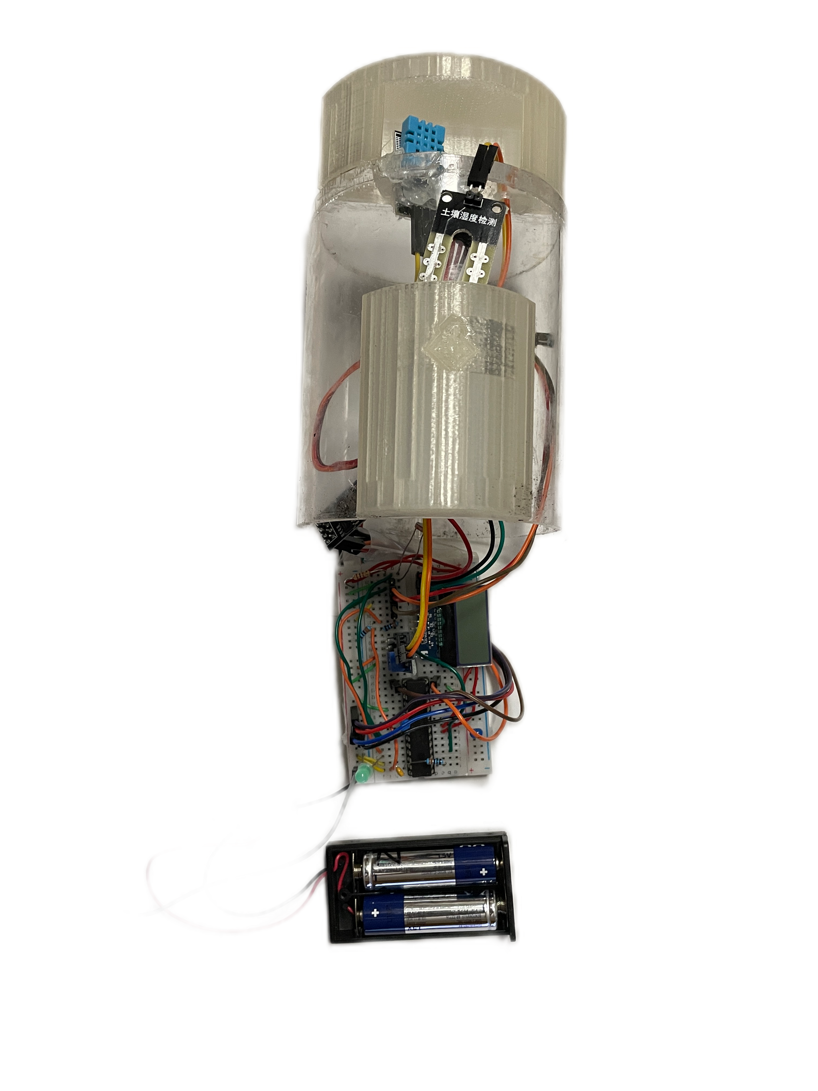
What we’re currently working on:
Outreach
Partnerships
Features
Innovation
Conduct market research, build devices, and spread the word through local events.
Expand to an inventory of 15+ devices and partner with small local gardens & greenhouses.
Provide machine learning software and additional sensors to cover as much ground as possible.
Develop passive wireless communication strategies in even the most remote areas.
We are looking to hear more from you! If you are interested in hearing how FarmGrid can help you or have any thoughts on features, contact us at https://farmgrid.ml

